Slide 1
Generating meteorological diagnosis using LLMs
RESEARCH REPORT III
Thesis advisor
Conf. dr. ing. Traian-Eugen REBEDEA
Claudiu ADAM

Slide 2

MOTIVATION
LLMs demonstrate potential in specialized domains
Application to meteorology remains unexplored
Need for accurate weather interpretation and data explainability

Slide 3



EXPERIMENTAL APPROACH
Generate weather diagnoses
Produce accurate meteorological interpretations of daily weather diagnoses from Romanian ground station data (Bucharest)
Compare approaches
Few-shot Chain-of-Thought vs. Parameter-efficient fine-tuning using Zero-shot
Evaluate LLMs
Assess capabilities of 8 models for meteorological reasoning

Slide 4
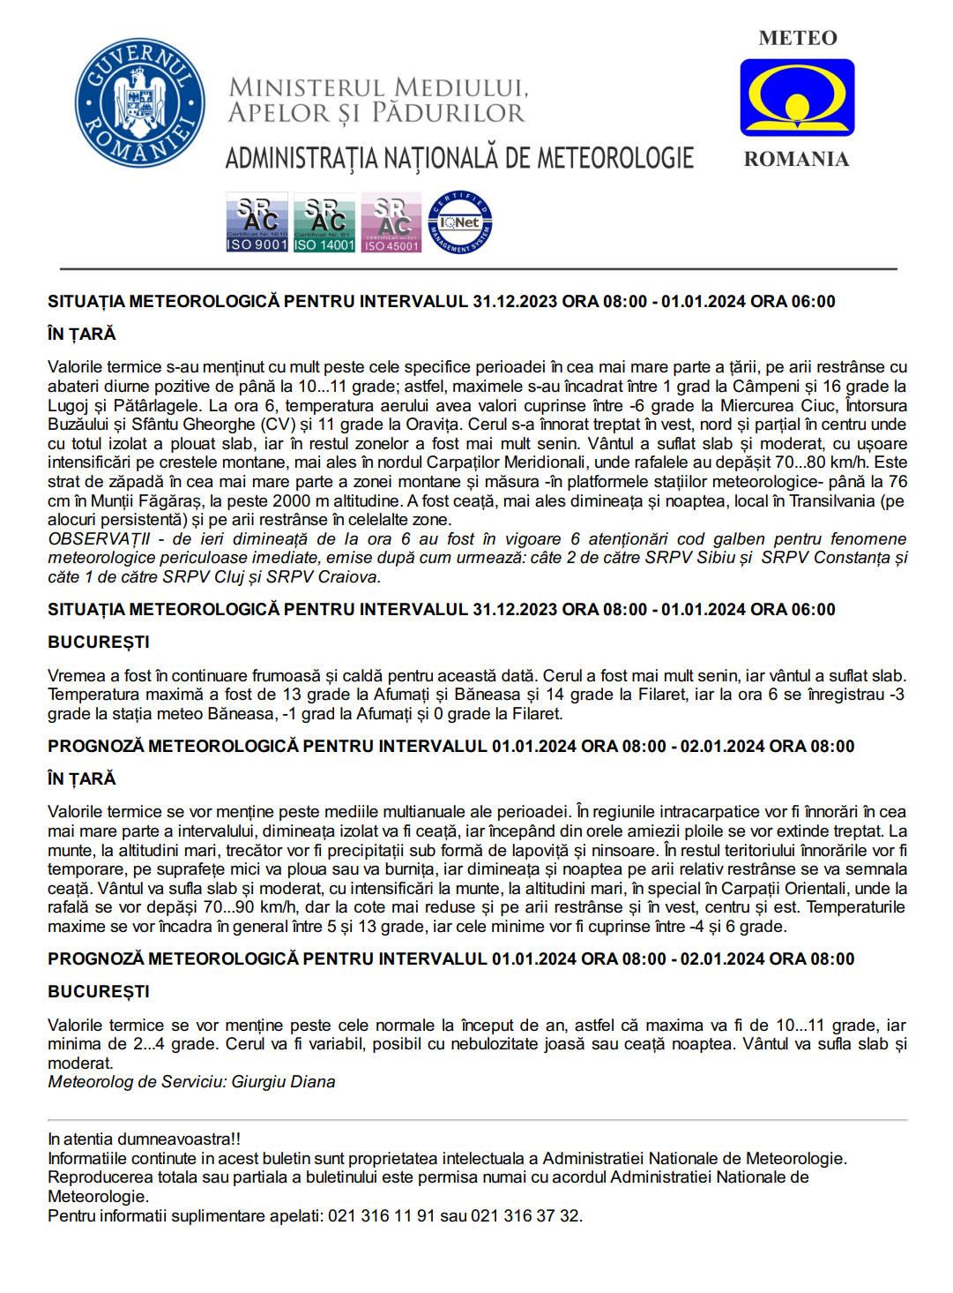


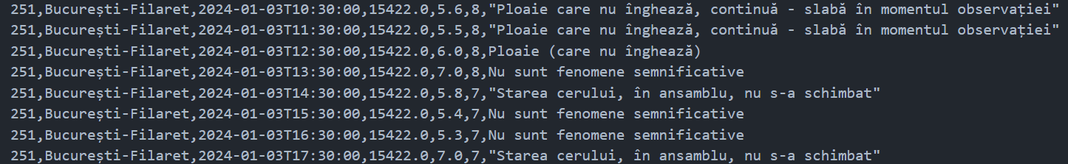
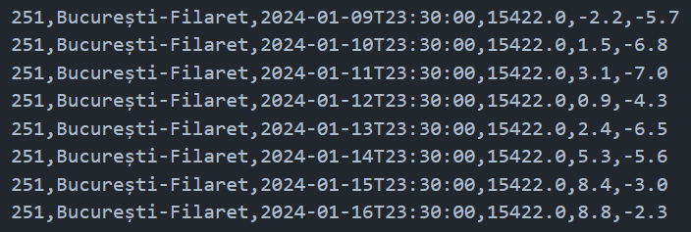
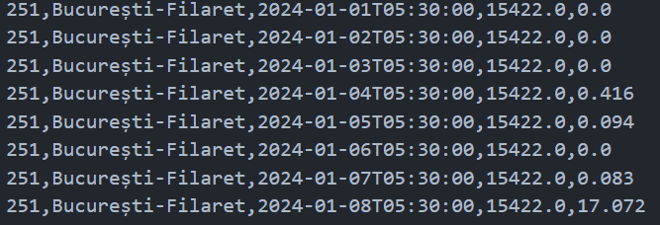
DATA SOURCES & VALIDATION
Bucharest weather stations
Filaret | Băneasa | Afumați
Data validated against diagnoses from Romanian NMA
Meteorological variables
Temperature | Precipitation | Wind speed | Cloud coverage | Weather phenomena
Hourly and daily temporal resolution of data acquisition
Wind speed | Cloudiness | Event
Tmax | Tmin
Precipitation rate

Slide 5

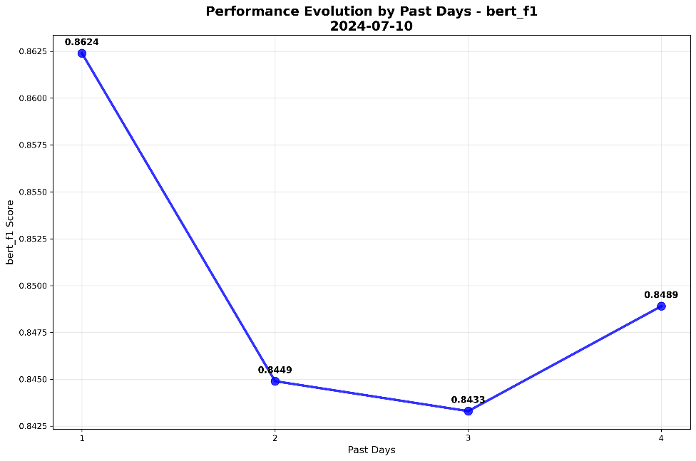
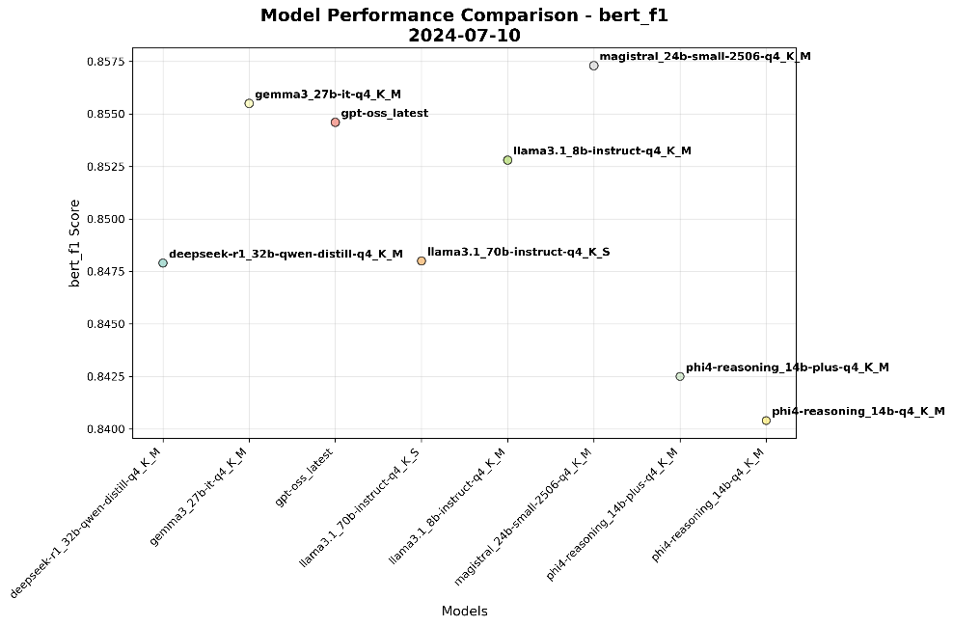
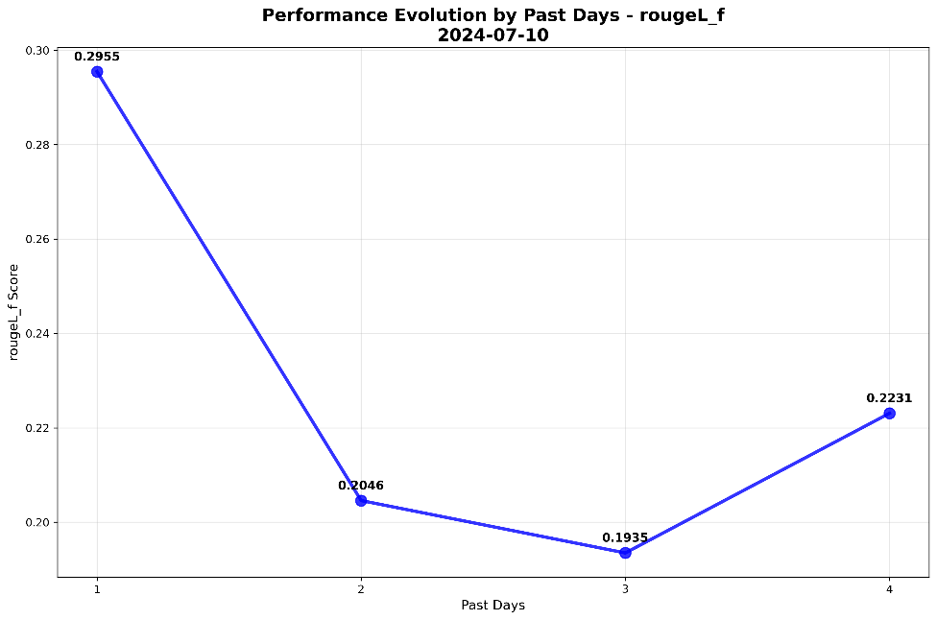
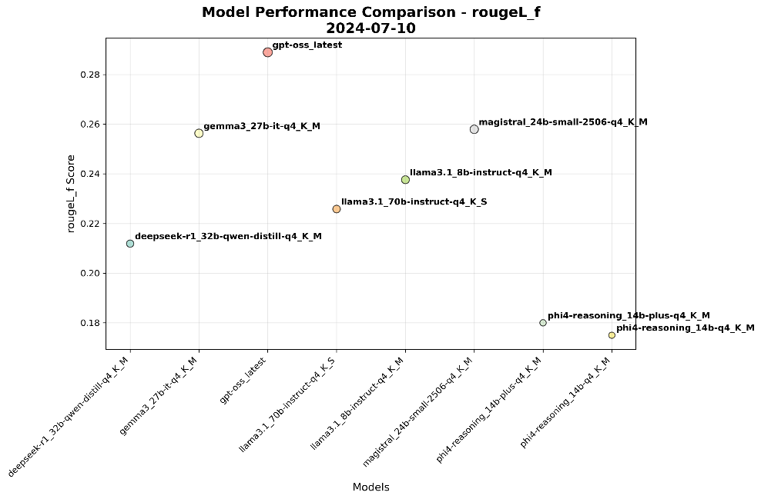
RESULTS: FEW-SHOT CoT (1)
Text of a diagnose contains around 5 statements about general weather observations (gpt-5-mini generated step-by-step user prompts)

Slide 6
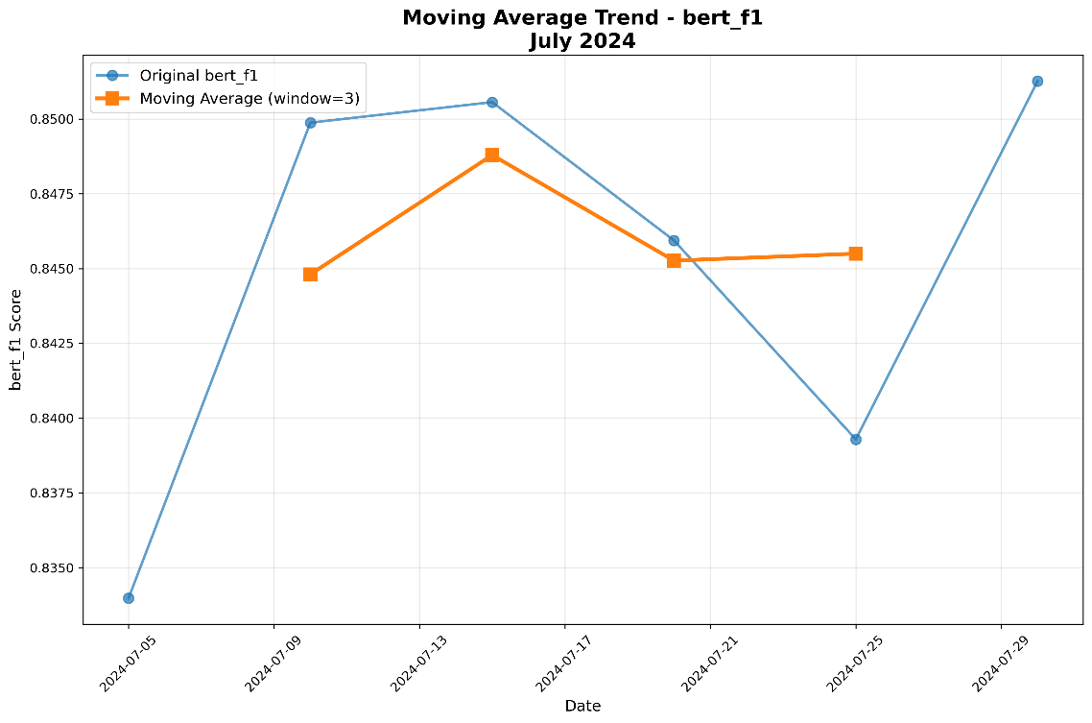
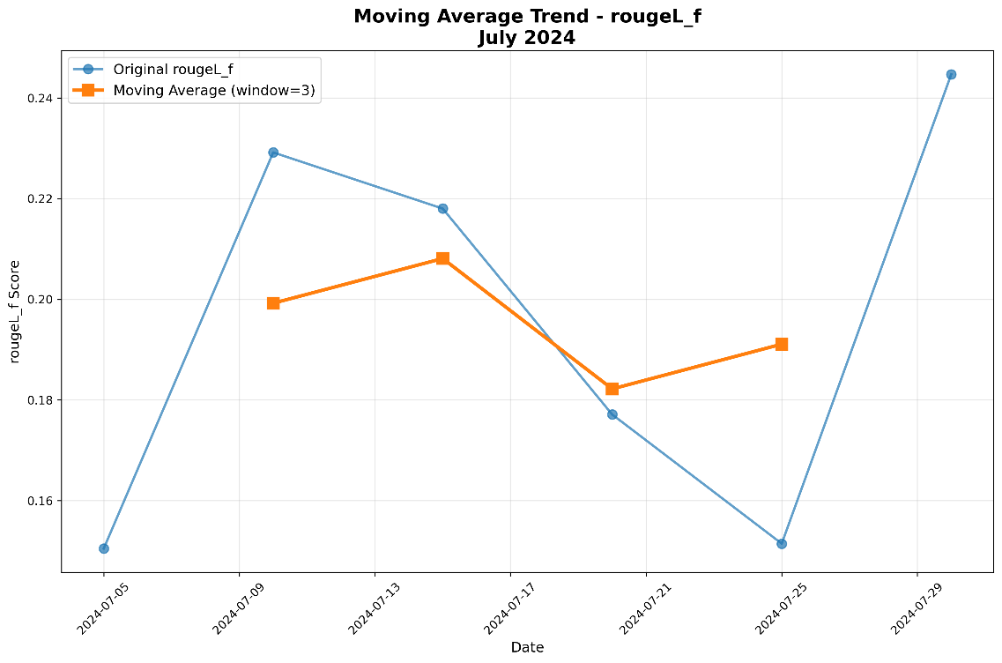
RESULTS: FEW-SHOT CoT (2)

Slide 7
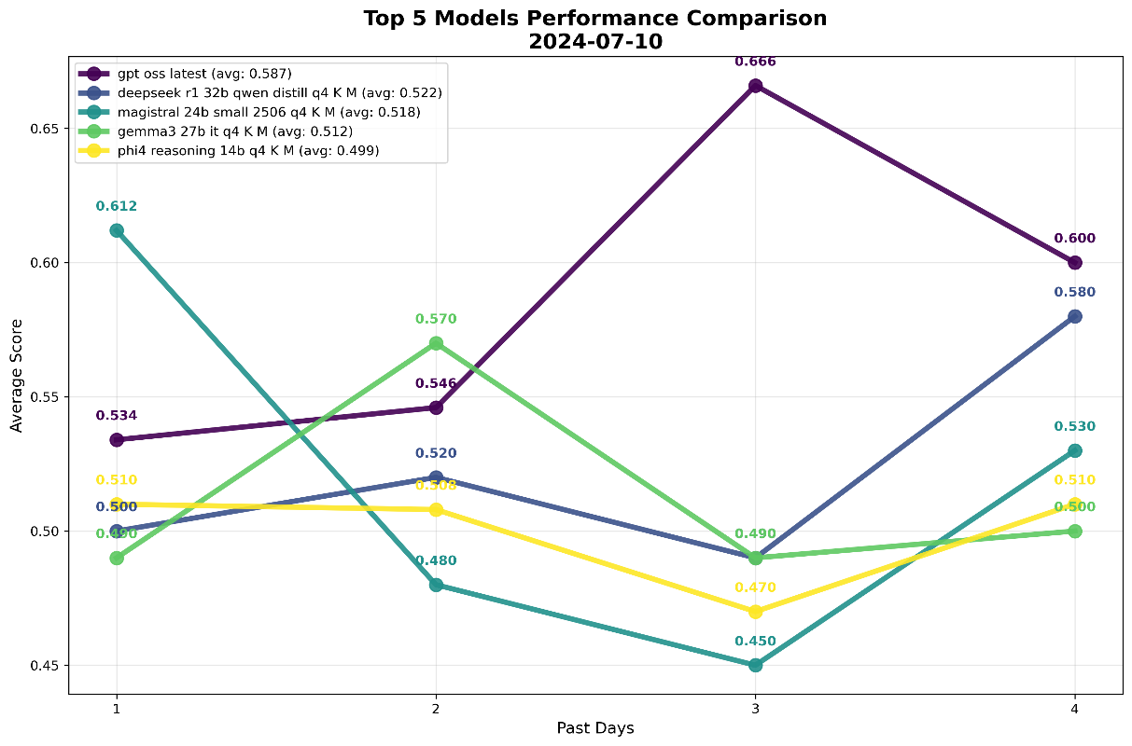
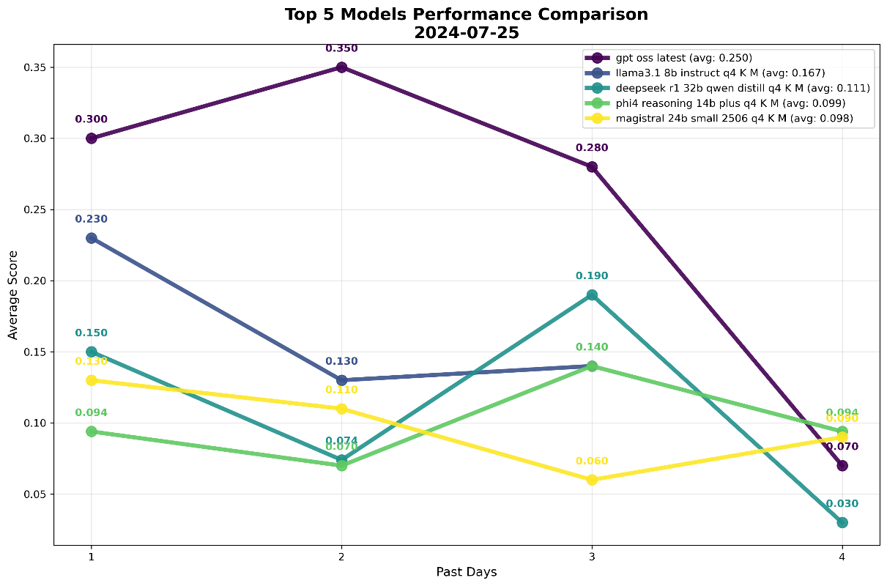
RESULTS: FEW-SHOT CoT + LLM-as-a-Judge
-> The judge model (gpt-5-mini) receives detailed evaluation criteria and generates correlation scores between each sentence
-> It handles both four and five-sentence analyses, validates score ranges in the interval [0, 1], and calculates average correlations

Slide 8
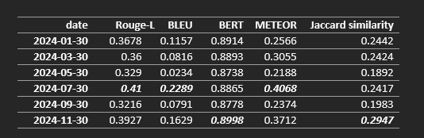
RESULTS: Llama3.1-8B-Instruct fine-tuning
-> Parameter-efficient fine-tuning using LoRA adapters with rank 32 for 4-bit quantization - only the weights of attention and feed-forward layers remained trainable
-> Fine-tuned through HF for 3 epochs with 2e-4 learning rate
-> Zero-shot fine-tuning: system prompt with an instruction-based structure, user prompt containing an average over the weather data for the past 24 hours, and assistant response with ground-truth diagnosis
-> ROUGE-L - 0.41 compared to the CoT average of ~0.25
-> BERT Score - 0.8865 compared to the CoT average of ~0.85

Slide 9

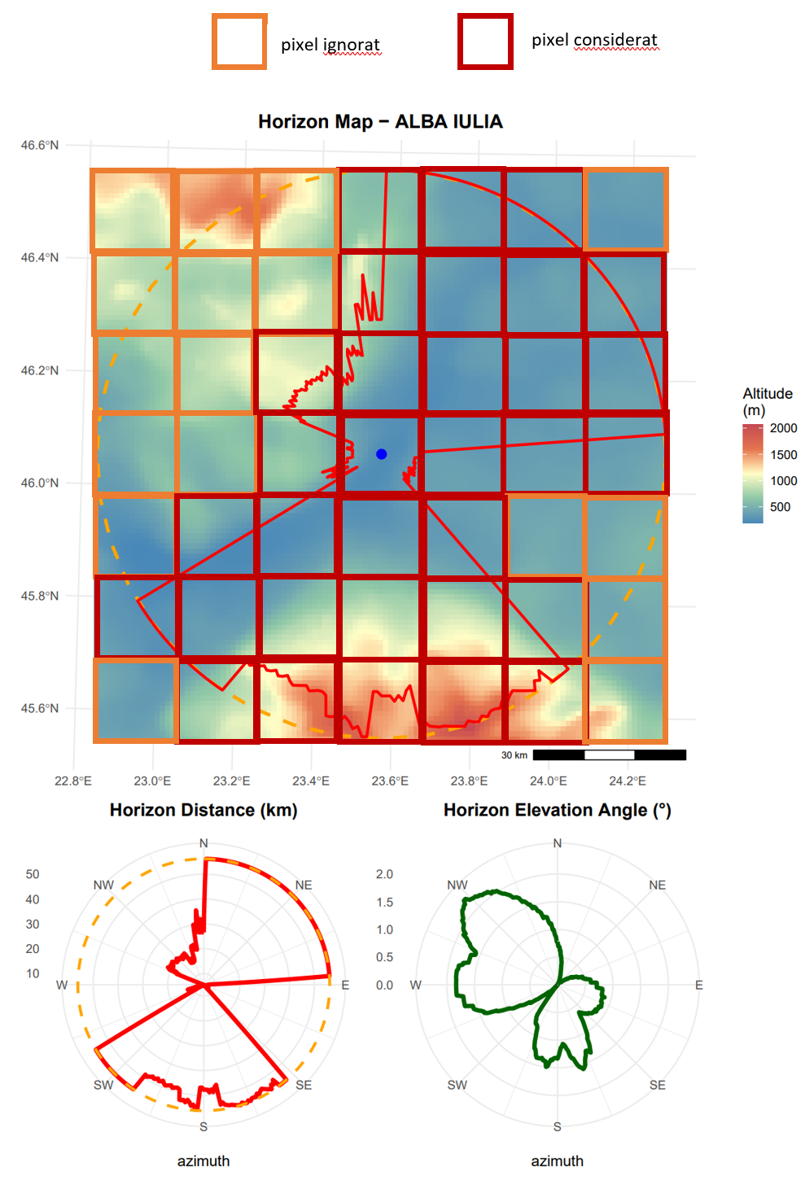
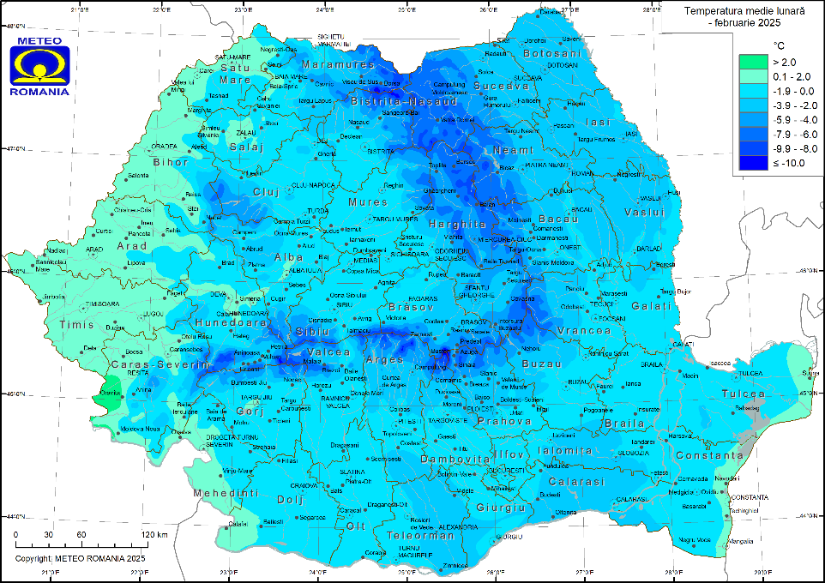

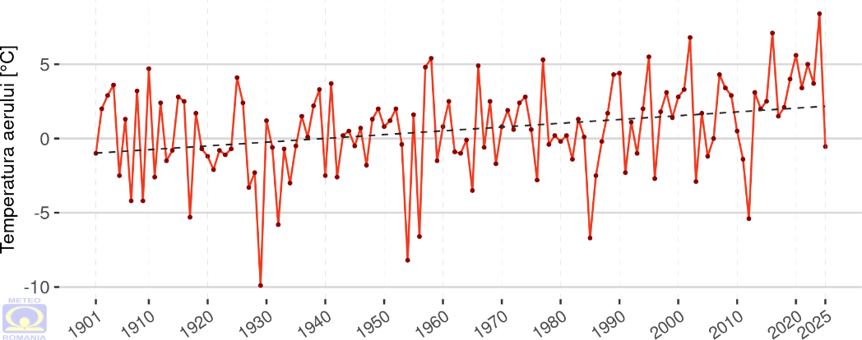

FUTURE WORK
Types of data to use:
diagnoses and forecasts + numerical data from weather stations (text)
cloudiness values ​​from weather stations can be defined from satellite data [1]
maps are valid between 2021-2025 for each month [2]
we can extract historical data from the images using the OpenAI API [3]
The idea to implement:
Transforming diagnosis and prognosis texts into a times series dataset + applying the few-shot CoT prompting strategy (or other strategies) on the Bucharest data to make the connection between the diagnoses from the current day and the forecasts from the previous day
LLM will have to give a confidence score at the end of each answer (in the range [1, 10] how confident it is in the given prediction
example: monthly average temperature (ground-truth) – predictions improve as month progresses and more data is gathered – incorporating memory
Baselines:
Mean
Persistence
Linear regression
N-BEATS

Slide 10
THANK YOU

